Slide 1
Coffee go
Aim Smart Corp.

Slide 2
Aim Smart Corp.
Purpose
Vision
Idea
Improve the efficiency of coffee service by using innovative technology
Everyone can get a cup of the best fresh ground coffee anywhere and anytime
Becoming a high quality and household recognized brand in the coffee industry
Aim Smart Corp. found in Winnipeg on May 18th, 2018.
A technology company focusing on an innovating new way to deliver high-quality coffee to the consumer. Connecting face recognition, QR code scanning, & cashless payment within world-class coffee equipment.
O2O Business Model lead company to success

Slide 3
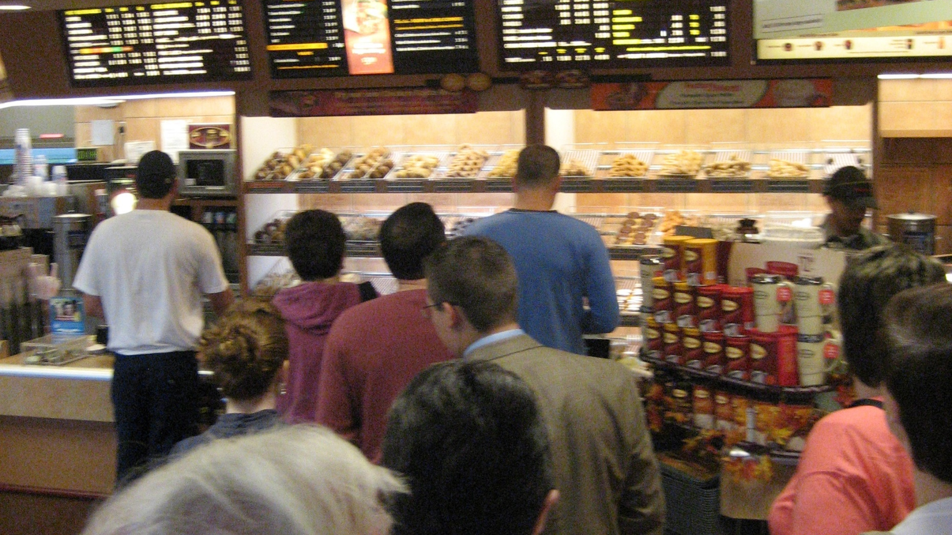
Traditional Coffee Shop Problem
Less Convenient
Line up for more than 10 to 30 minutes during peak hours (Universities)
Lower Quality
Hard to maintain high quality coffee under rush hour pressure
High Labor Cost
Hire more staff is necessary to improve rush hour efficiency, but minimum wages are keep increasing
Lost Revenue
Customers who are unwilling to wait long periods of time will go to another coffee store
Efficiency Problem

Slide 4
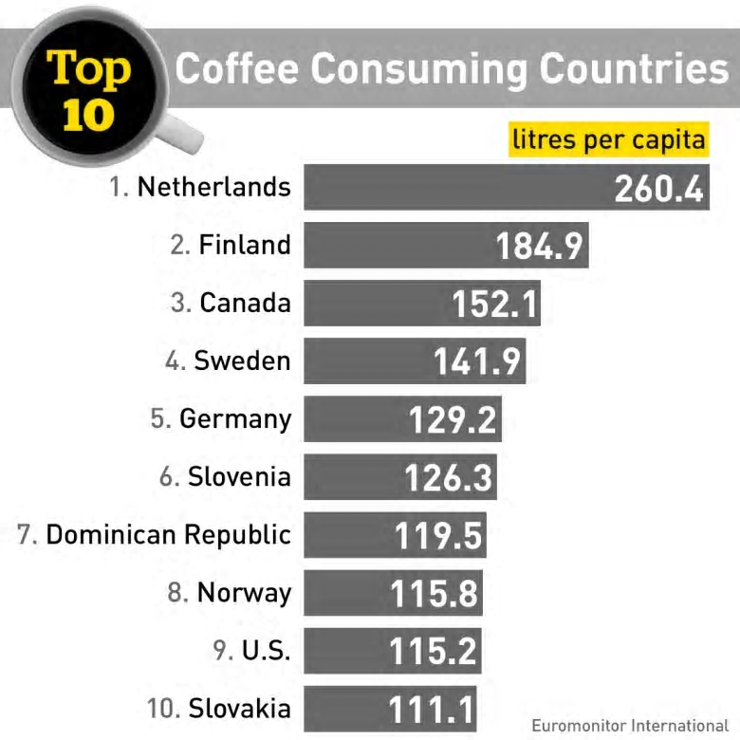
Canadian Coffee Market
According to Coffee Association of Canada, in 2017, Canada's coffee industry created $6.2 billion, which included $4.8 billion sales in foodservice and $1.4 billion sales in Grocery or retail sales.
According to CBC News,
Canada reached top 1 position in coffee consumption in 2015
total amount of brewed coffee consumption is about 152 litres per person

Slide 5
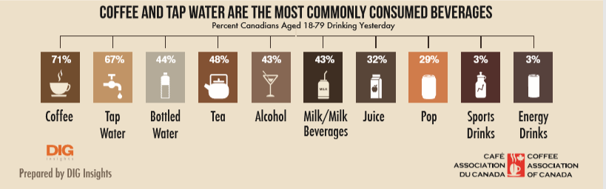
Beverages Consumption
According to Coffee Association of Canada, coffee is the highest beverages consumption in Canada, which is about 71%.

Slide 6
Target market
Coffee lover
Students (70,000 at U of M, U of W, Red river college)
workers(90,000 ~ 100,000)
Anyone who need Beverages

Slide 7
Opportunity
Office workers and students need coffee to enhance mental performance and work efficiency
Long line-up = time waste
Customers demand high-quality coffee during peak hours
Growing demand with Smart ordering technology (skip the dishes, McDonald’s App)

Slide 8
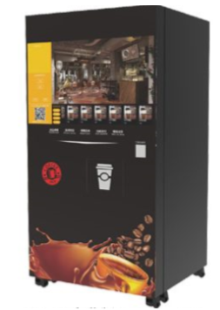
Automatic Bean to Cup Coffee Machine
Mobile App (QR code for pick up)
No face to face communication
Only 45 seconds to get a freshly ground coffee
Operates as a 24 hrs
Cheaper price
Taste is the same as that of the ordinary coffee shop
Small area space (<1m²)

Slide 9
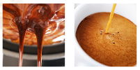
Automatic Bean to Cup Coffee Machine
Small footprint, convenient to put it anywhere
Hydraulic System from Italy Componenti
High-Pressure Espresso Coffee Brewer （19 Bar）
Italian high-quality coffee grinder
45 second bean to cup
more than 40 types of beverages
Increased revenue through ad placement during & after point of purchase
Intelligent Coffee Machine Operation Management System
Self-cleaning system

Slide 10
Automatic Bean to Cup Coffee Machine
Dimension | 820*1000*1900(mm)
Weight | 220 – 280 KG
Location | Universities, libraries, parks, gyms, shopping malls, business buildings, bus stations, airports, hospitals, and other public places
Display screen | 43” capacitive touch screen (customized user interface, multiple language)
Communicate port | USB, WIFI, 4G, RS232
Payment | QR code/cashless/card reader/NFC/VISA/Mastercard/Apple Pay/Android Pay/Google Pay
Water supply | Water pump
Machine speed | Instant drinks:25S/espresso drinks:45S
Certificate | CE/ROHS/ETL
Product list | Espresso, Americano, Cappuccino, Latte, Mocha, Macchiato, Hot Chocolate, French Vanilla, Black Tea, Green Tea, Milk Tea, Iced coffee, Iced Cappuccino, etc.

Slide 11
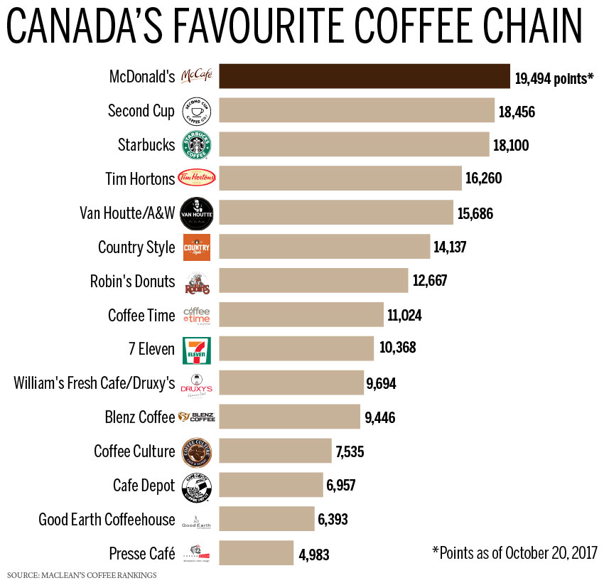
Competitors –Traditional Coffee Shop
Canada’s most popular coffee brand：McDonald’s, Second Cup, Starbucks, Tim Hortons, Van Houtte/A&W.
According to the statistic data from Maclean’s Coffee Ranker, in 2017，McDonald’s coffee score the highest points.
Source: MACLEAN’S COFFEE RANKINGS

Slide 12
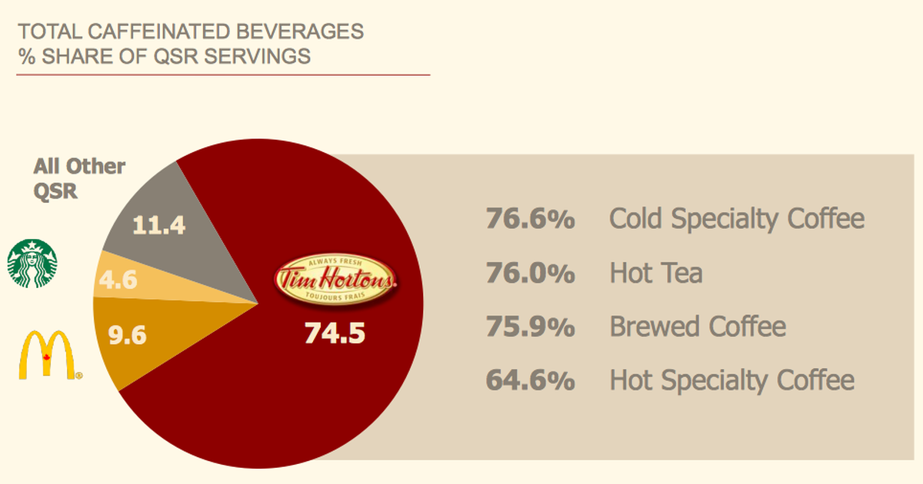
Competitors-Traditional Coffee Shop
According to Coffee Market Share Canada Tim Hortons, the statistics in Quick Service Restaurant Servings shows that the percentage of total caffeinated drinks of Tim Hortons, McDonalds, and Starbucks are 74.5%, 9.6 %, and 4.6 % respectively.
Source: http://market.fodo.us/coffee-market-share-canada-tim-hortons/

Slide 13
Our Advantages -Traditional Coffee Shop
No face to face communication with customers
Avoids communication mistakes (failing to listen to the correct order)
Cashless payment method decreases the time for cashier to make change
Ordering from any place at any time
Multiple ways to pay
Consistency with taste and quality
99.7% success rate

Slide 14
Competitors-Traditional Coffee Vending Company
Van Houtte
Second Cup
Marley Coffee
Focus on coffee vending at business workplaces
Coffee vending is not the business they concentrated in Canada
Only located in a few locations such as casino

Slide 15
Competitors-Traditional Coffee Vending Company
Costa Express
Aramark
Others
Partner with Shell in 2016
Old & few users
Old traditional coffee vending machine
No longer in Canada
Few kinds of drinks
School
Factory

Slide 16
Our Advantages – Traditional Coffee Vending Company
Better Quality Coffee
fresh milk instead of milk powder
Brews and grinds same taste as the traditional coffee shop
100% Arabica Coffee Beans
Significant parts of machine are manufacturing and engineering from German and Italy
40 types + of hot and cold beverages

Slide 17
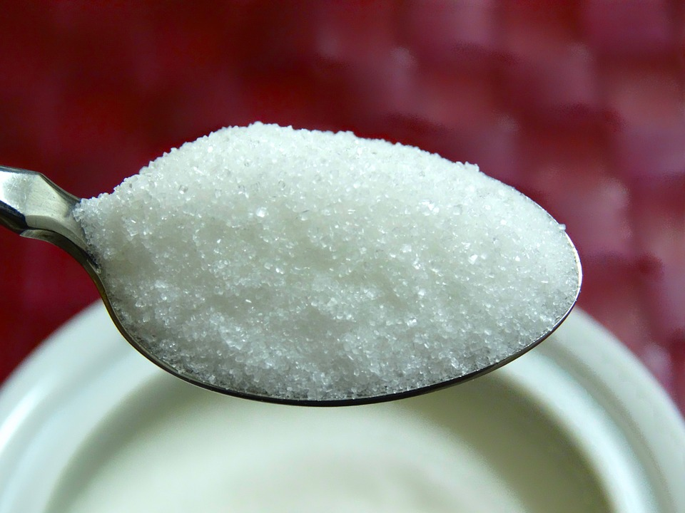
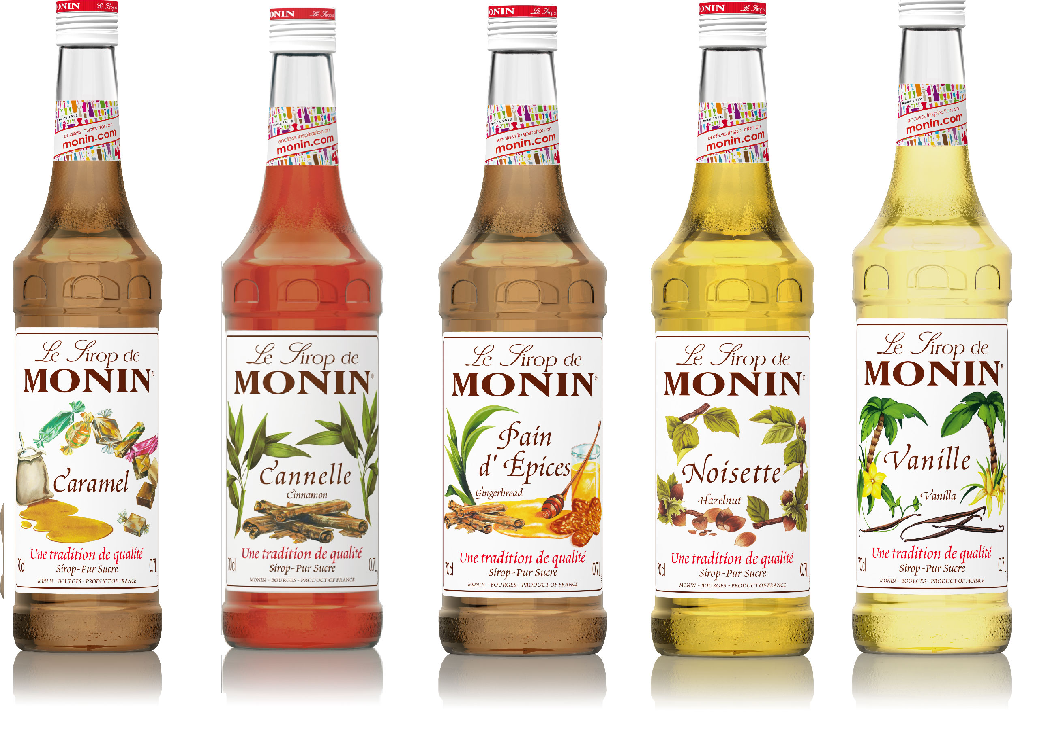
Our Advantages
Cane Sugar Syrup — dissolve better
Our coffee is “made-to-order”

Slide 18
What makes us different!
Face Recognition System, store customer preferences
Insulated. Protects hands from steaming hot or ice cold beverages.
QR Code scanning & Cashless payment Methods
Ice Beverages, Summer Drinks
Refrigeration System for Fresh Milk, high-quality milk foam

Slide 19

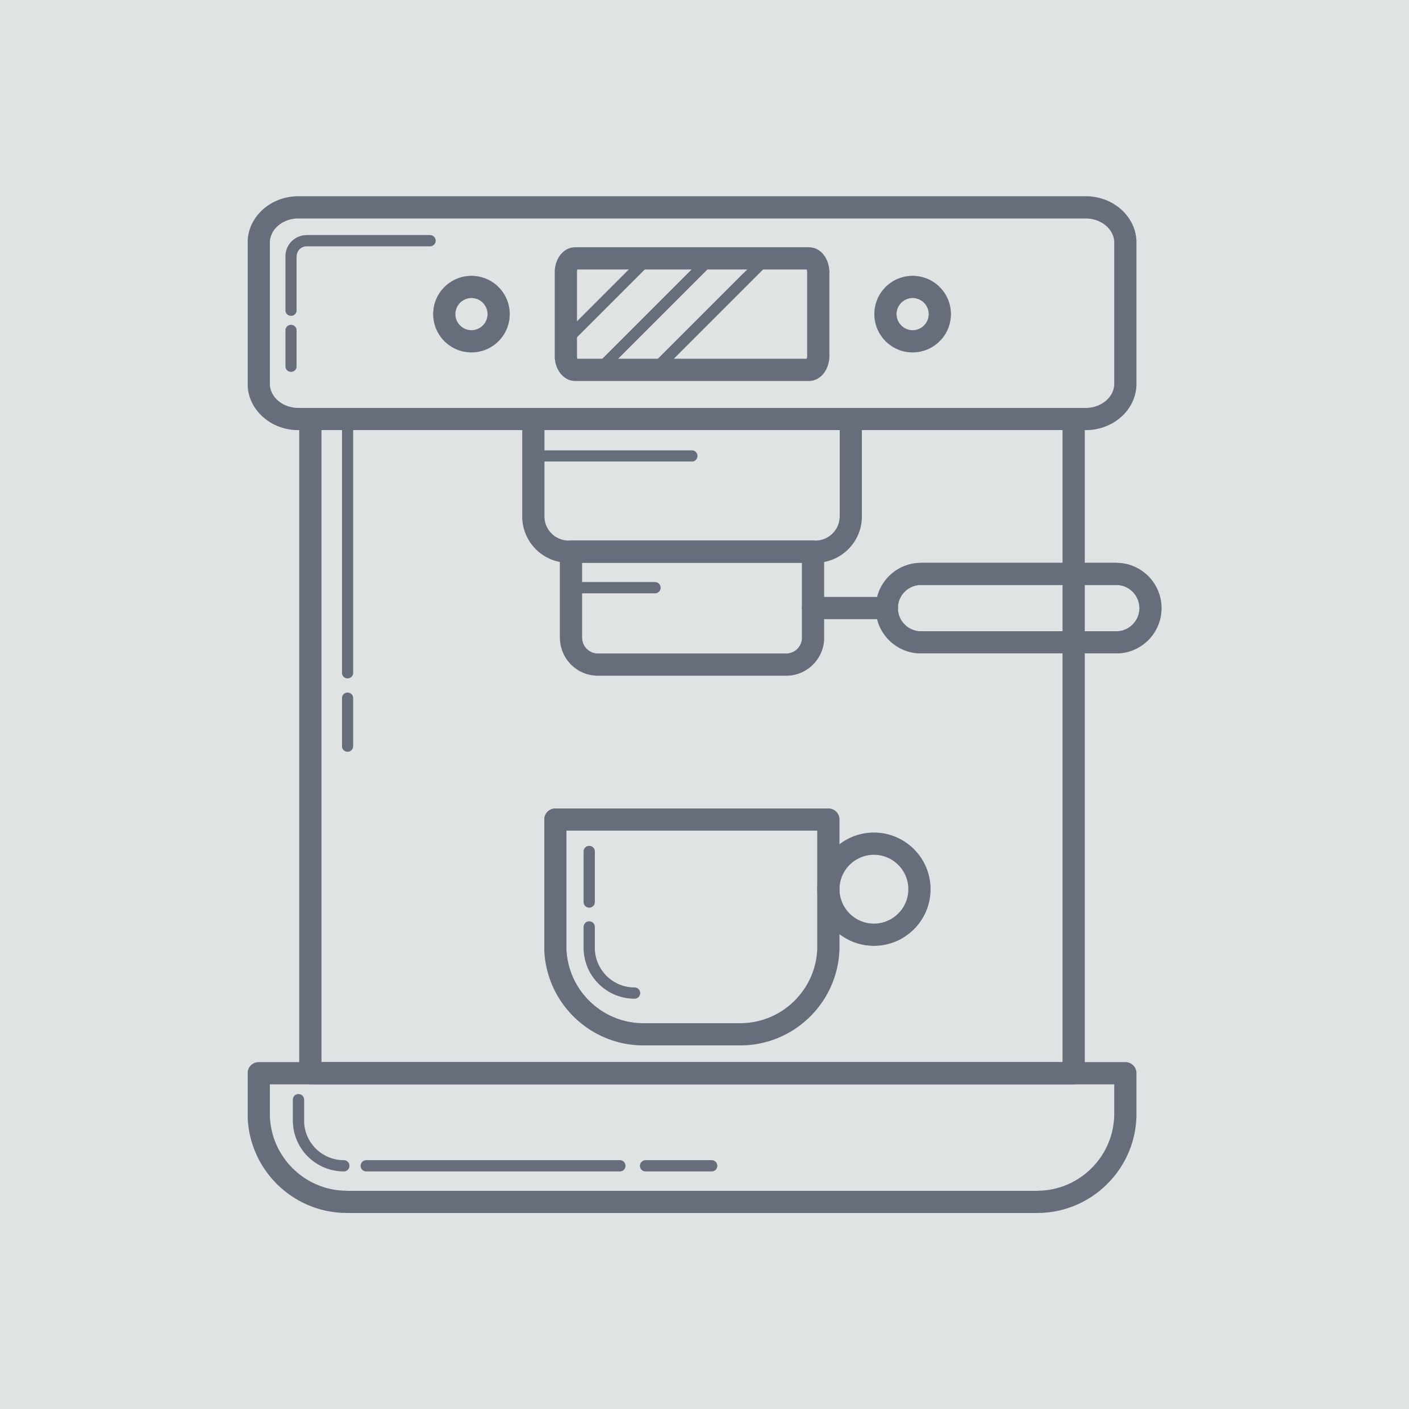
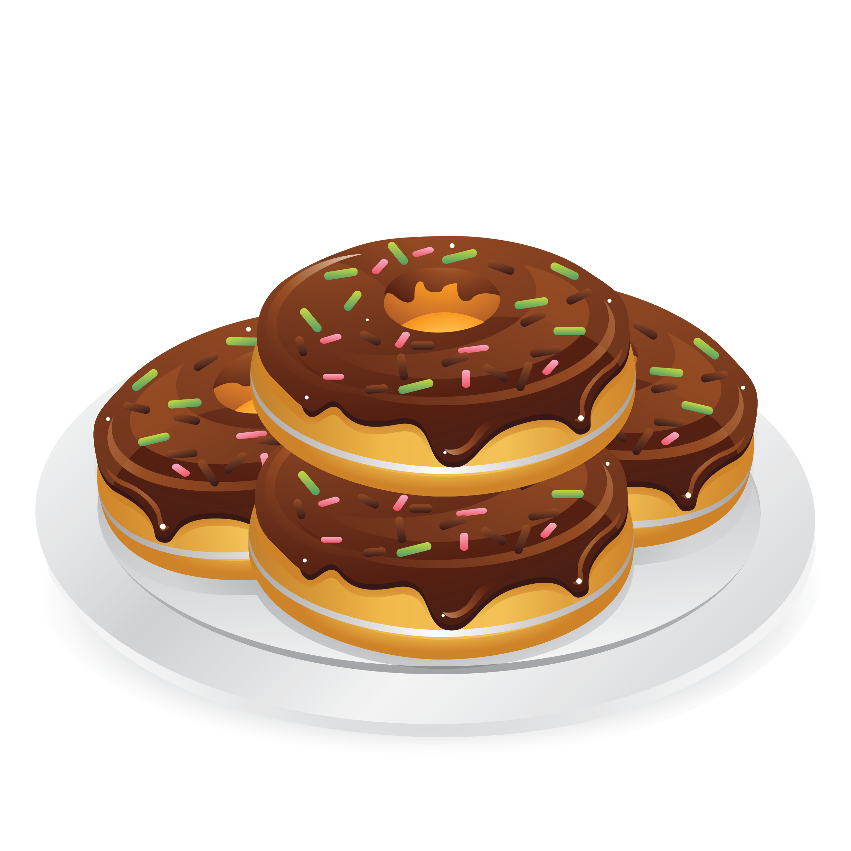
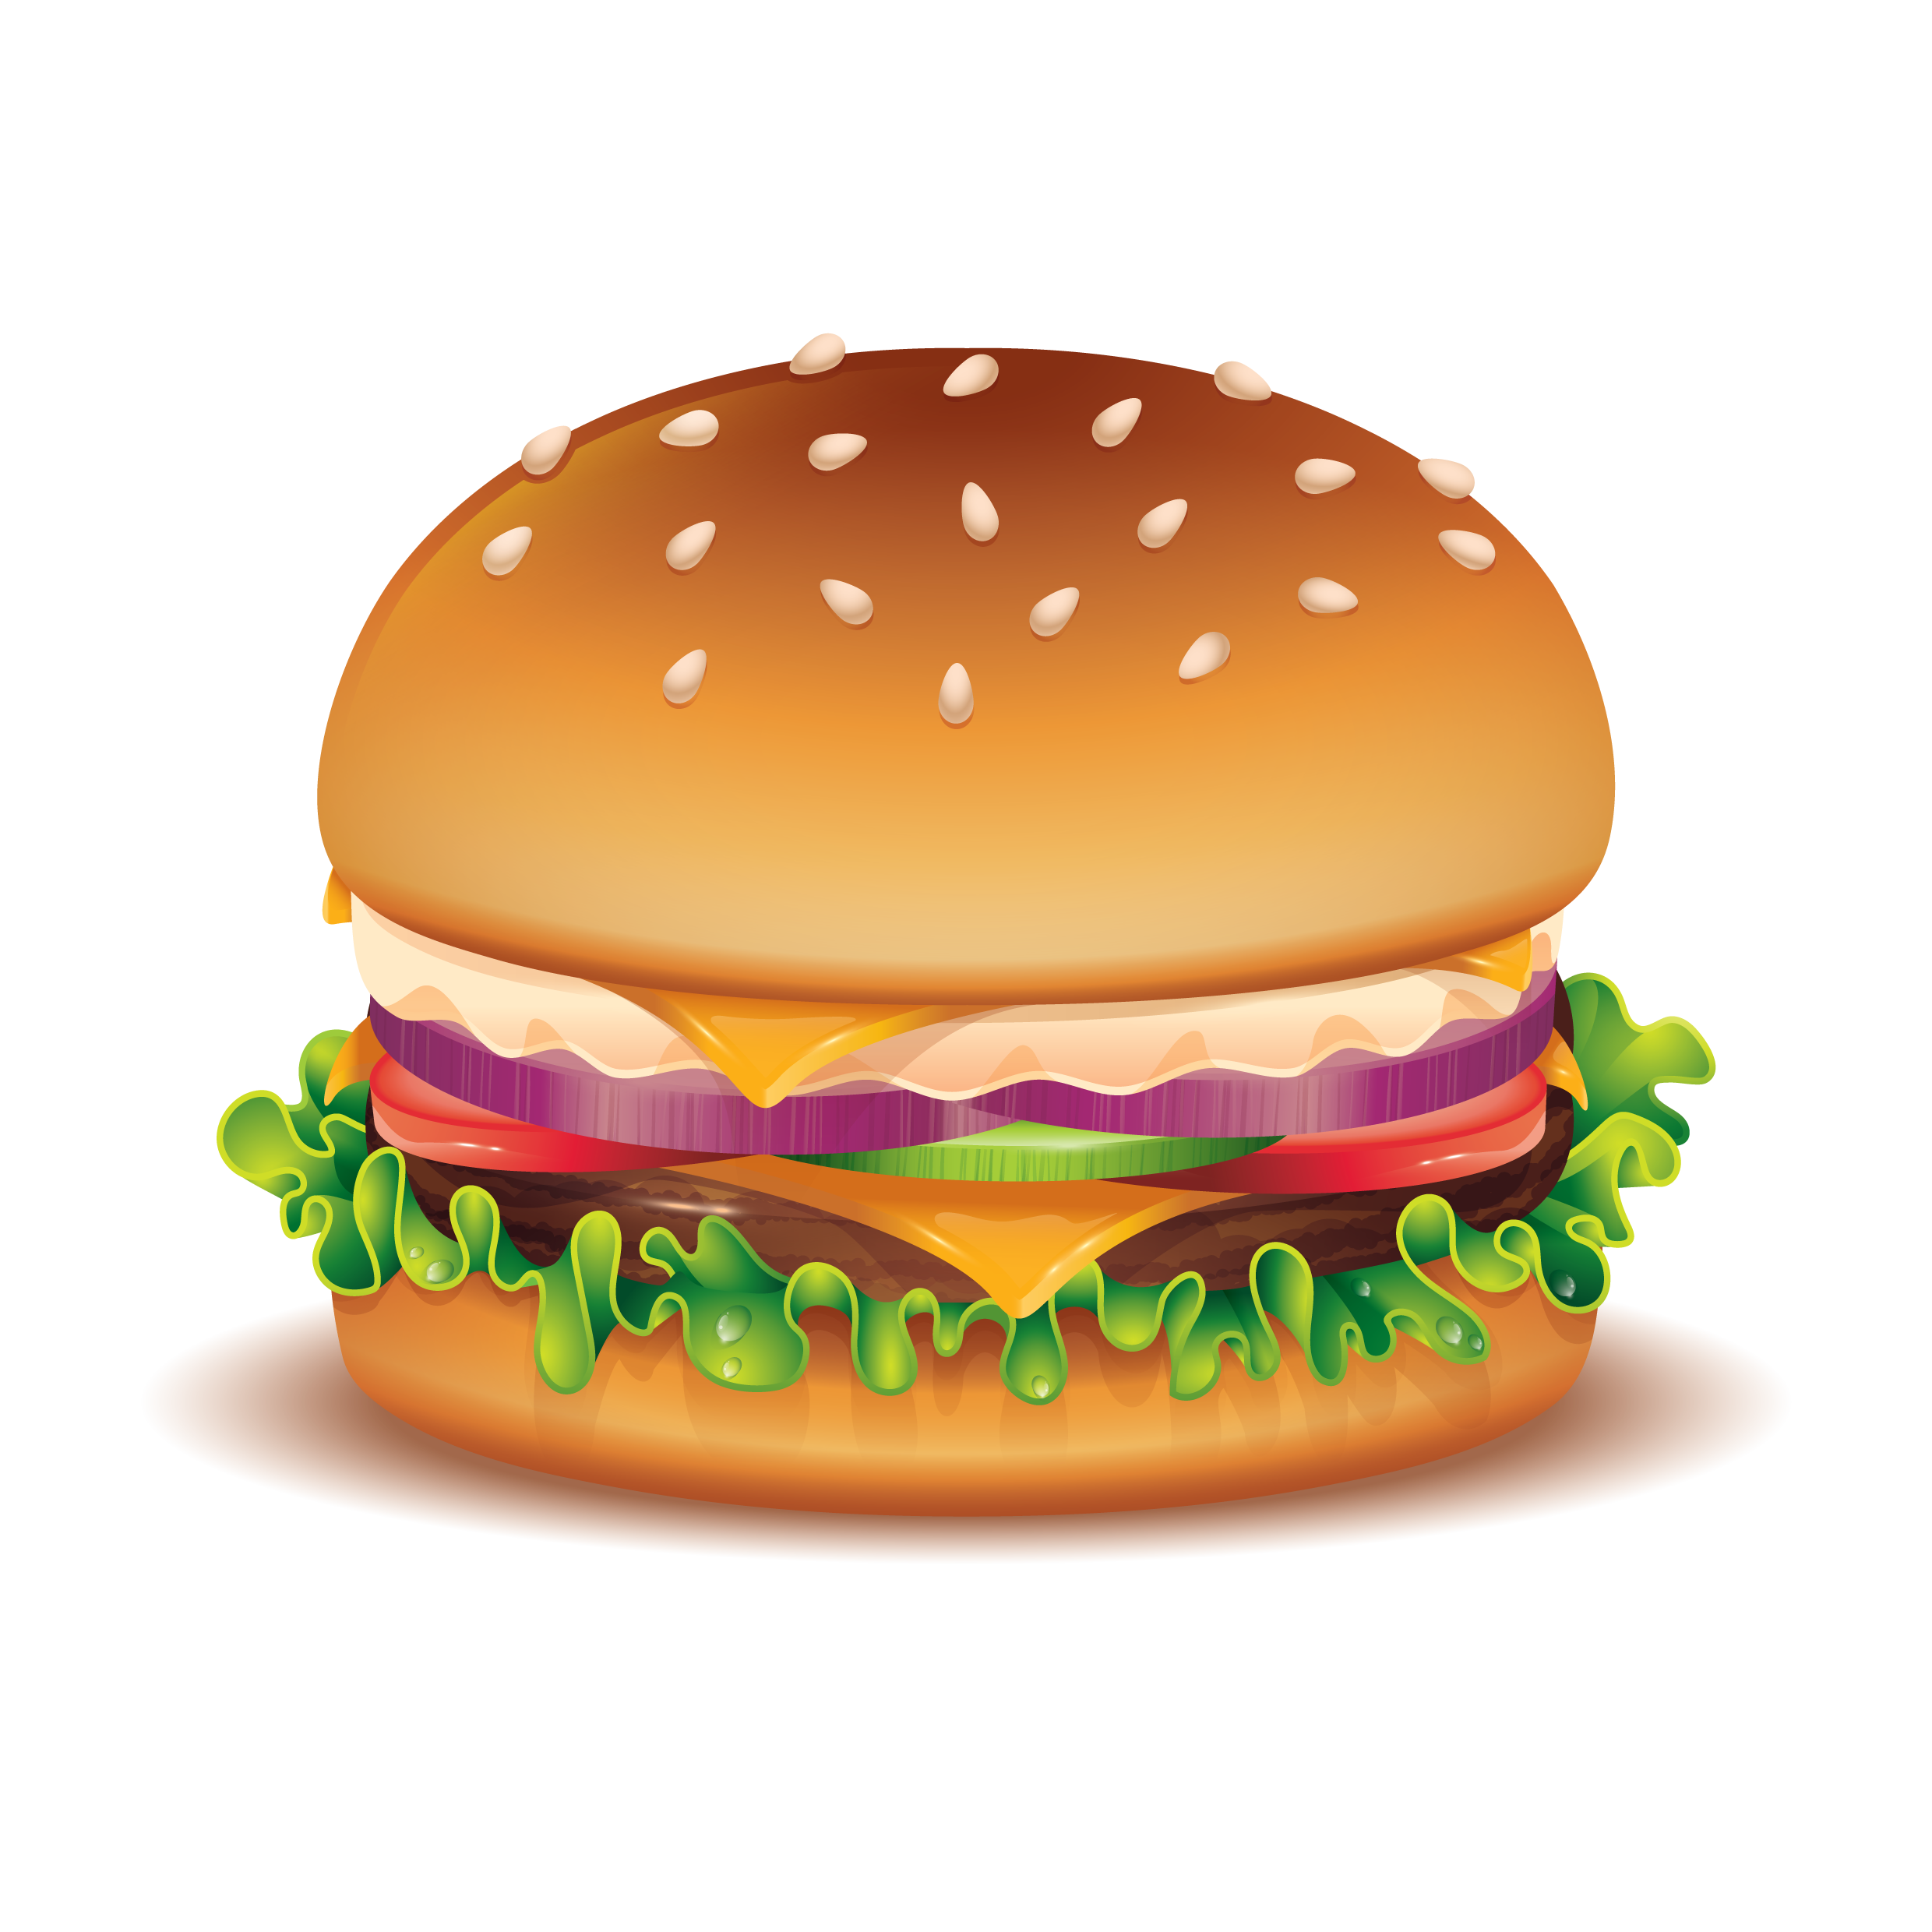

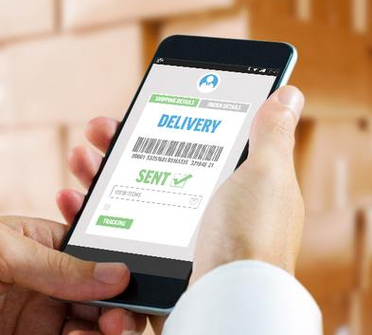

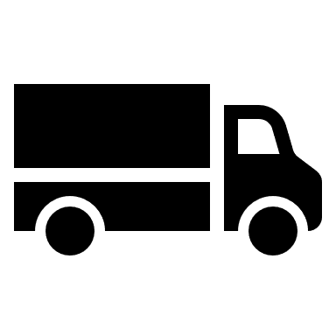

Customer | Encrypted Computer Servers | Automated Beverage Machine | Automated Bakery Machine | Automated Sandwich Maker | Positioning System | Packaging Machine | Facial Recognition System | Maintenance & refill
First Time？
Y
Registration
Store customer facial information & create encrypted data base
N
Provide reason & display message
View Menu in APP
Decline
Track customer distance
Make Order in APP
Accept
Y
Start?
N
Request Payment
Start Making
Start Making
Start Making
Customer Arrived?
Confirm customer identity
Decline
N
Choose & Make Payment
Y
Y
Success
Calculate Processing time？
Packaging
Receive Food & Drink
Hand to customer
Analyze Stock Level & Condition
Y
Create product requisition for product suppliers of i) consumables ii) perishables
Create requisition for refilling of machines
Stock – requisition for refilling = requisition for i) consumables ii) perishables
Refill & Maintenance？
Maintenance & Refill
N

Slide 20
SWOT Analysis
Strengths
New coffee serving style
Weaknesses
Traveling cost between different location for maintenance $ refill
Opportunities
Threats
High competition in coffee market
Coffee health issue
High quality coffee on demand
High efficiency, short wait time
Online ordering, cashless payment, convenience & popular locations
Low labor costs & space rental fees
Limited types of products compared to traditional coffee shop (food)
Smart Coffee vending and cashier-free coffee shops are in it’s “infancy period” in Canada
Different sources of revenue, ads& product
High coffee demand in Canada
Online food ordering and App ordering are getting more popular (eg, skip the dishes, uber eats)
Required high cost on machine purchasing
No enough related experience in coffee industry
A long-term project for building a well-known quality coffee brand may lead to imitation through low barriers of entry into the market
Becoming the first innovator has more advantages in the future for growth & expansion
Intelligence operating system lower operating cost
Hard to replace traditional coffee shops

Slide 21
Coffee Go Business Model Canvas
KEY PARTNERS | KEY ACTIVITIES |  | VALUE PROPOSITION |  | CUSTOMER RELATIONSHIPS |  | CUSTOMER SEGMENTS
Suppliers: Coffee Machine Coffee Beans & ingredients Cups & lips Water Face recognition System Cashless Payment System Other Partners： Rental space providers Investors Advertisers Media | Building quality coffee brand Creating best customer service Purchasing Product R&D Marketing and Advertisement Rental space negotiations |  | Best Quality, Best Value, Best interactive Experience, High Speed, High Efficiency, Get the best coffee anytime and anywhere Improving traditional coffee shop serving: APP and online ordering is more convenient High-quality coffee, always ground fresh Convenient Cashless payment None to very short waiting time Better coffee servicing experience Good feeling of value through APP cost & efficiency of product with rewards for returning customers |  | Customer feedback system Long-term Brand Loyalty Customer Promotion Facebook，Instagram，Twitter, and other social media E-membership |  | Coffee Lover Student White collar worker Anyone who need refresh
 | KEY RESOURCES |  |  |  | CHANNELS
 | Improving efficiency Ensuring coffee quality O2O model Low operating cost Intelligent data analysis |  |  |  | APP Website
COST STRUCTURE |  |  |  | REVENUE STREAMS
Coffee Machine Coffee Beans Ingredients (milk, water and cream) Other Drinks ingredients (tea, ice) Packaging (cups & lips) Custom. brokerage & Duty fees Space rental cost Office rental for management Equipment maintenance Market research |  | Product design for new add on technology Human Resource Promotion cost & Advertisements Developing Cost: Programing Face recognition Payment system App Website |  | Sales revenue from Coffee & other drinks Advertisements Franchise income for future stores Machine leasing income

Slide 22


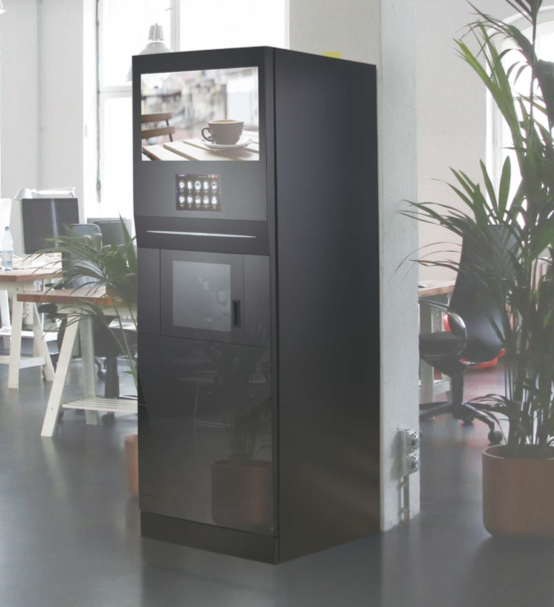


O2O (Online-to-Offline)
Offline To Online | Intelligent Operation Management System | Online To Offline
Customer feedback system
E-membership
Brand Awareness
Customer preference data
Maintenance
Refill
Quality Control
Inventory
Development potential new customer online
Build a loyal customer network

Slide 23
Marketing Strategy
1st time download the App will get 1 coffee for free.
Refer to a friend, enter 5-digit code, he or she can get another free coffee, also his or her friend can get a free coffee since 1st time downloading.
Follow us on Facebook, Instagram, Twitter, and other social media, share and post coffee shopping experiences and tag #Best coffee for free#Coffee Go# , on any two social medias, will get a free coffee.
New
Customers

Slide 24

Marketing Strategy --- Multiplication Power
More convenience, more customers
Generating cost of Machines
Ad$R
Ad$R
Ad$R
Ad$R
Ad$R
Ad$R
Ad$R
Ad$R
Ad$R
Ad$R
Ad$R
Ad$R
Ad$R
Ad$R
Ad$R
Grow with increasing Demand
Conduct More Revenue from Advertisement

Slide 25
Three Steps
APP for Online ordering
Automatic Bean to Cup Coffee Machine
Robotic Barista in Shopping Center
Cashier-free coffee shop with Drive-thru

Slide 26
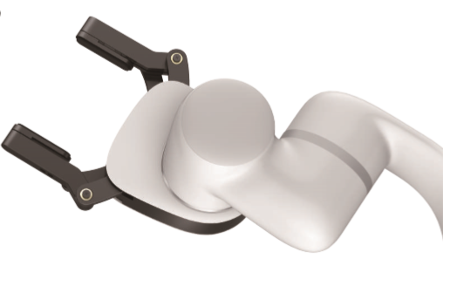
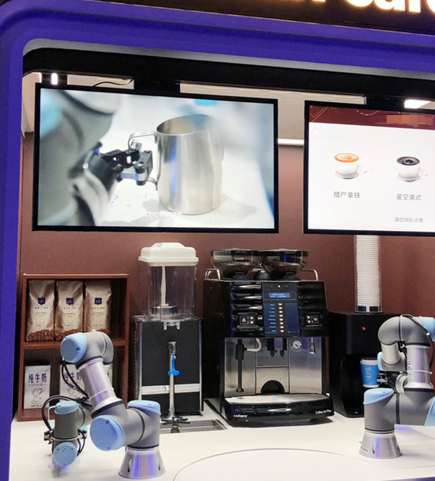
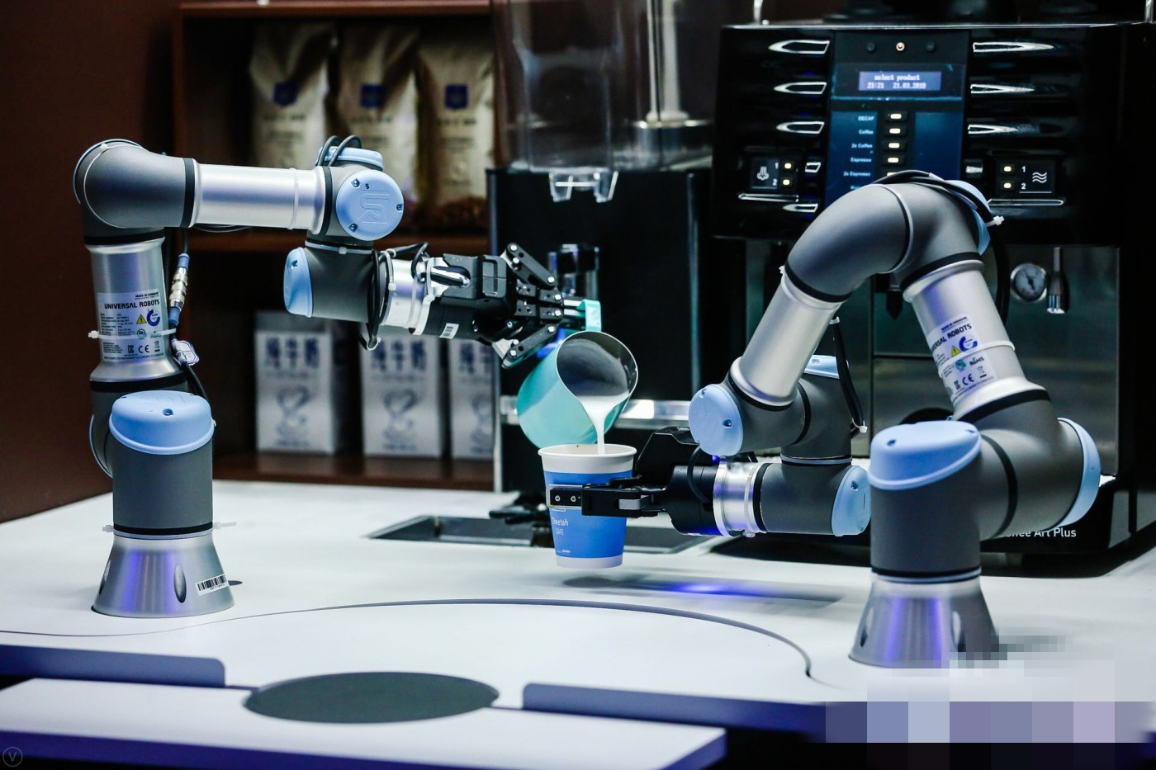
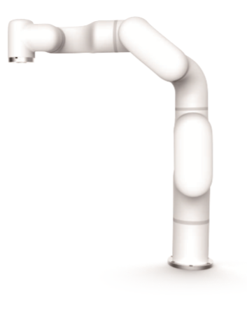
Robotic Barista in Shopping Center
Cashier-free, robotic arms replacing barista
Placing at high traffic areas in shopping center
Machine surrounded with clear glass to catch attention of the potential customers
Able to produce different types of drinks
App online ordering system, face recognition and QR Scanning for pick up, cashless payment systems. Has the option for typical card payment systems
Intelligent Operation Management System for maintenance and inventory

Slide 27

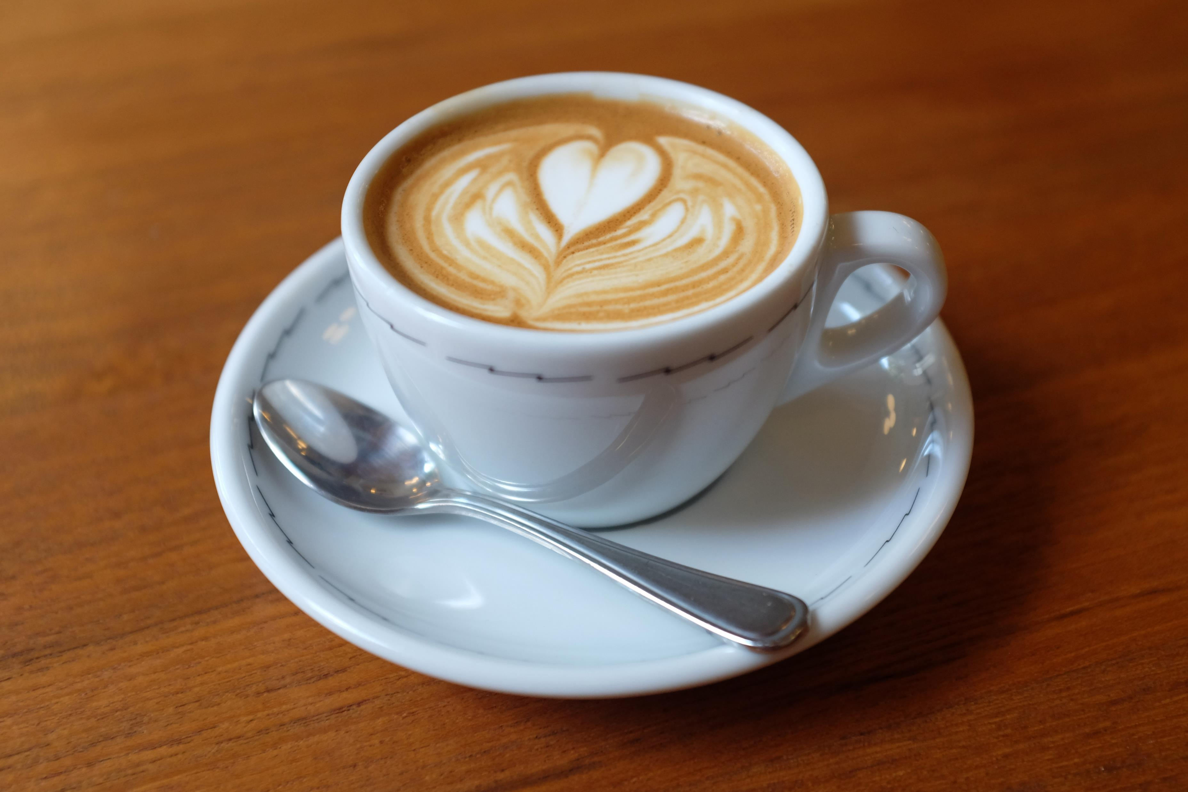
Cashier-free coffee shop with Drive-thru
Open 24/7
Face recognition for entry or scan mobile device
Touch screen Smart ordering table design
Robotic arms to handle all food-serving (drinks, desserts, sandwich)
High speed WIFI, table with cup warmer, fast charge, relax music work & study environment, cleaning robot
Intelligent Drive-thru system can recognize car and licence plate number for quicken order placement if customer is regular
will ask before making order to ensure correct product is produced.

Slide 28
Team
Dream
Building a well-known premium coffee brand
Young
Comprised of young staff eager to make a mark in the world
Professional
Certified barista, senior programmer, senior mechanic, MBA, CPA
Passion
Extremely passionate about delivering quality coffee of an affordable price point efficiently
Confidence
The product we build will shape the future of the coffee industry and lead us to success

Slide 29
Team Members
CEO
Qichun Y.
Graduated from University of Manitoba, Accounting & Finance Majors, degree of Bachelor of Commerce-Honours
Summer L.
Experience: 2 years in E-commerce, 3 years in e-cigarette manufacture industry, 3 years in restaurant
Studying for Master’s degree in University of Manitoba
Barista Certification
Graduated from University of Manitoba, Marketing & Finance Majors, degree of Bachelor of Commerce-Honours
Barista
Programmer
Dian
Senior Mechanic
Jorion S.
Couple of years experience in machine and hardware maintenance, five years experience as production manager
Graduated from University of Manitoba, Major in Computer Science

Slide 30
Advisors
Marketing
W.
MBA, graduated from University of Manitoba , major in Marketing and Supply chain
Accounting
Niki L.
Graduated from University of Manitoba, Accounting & Finance Majors, degree of Bachelor of Commerce-Honours
Accountant at a local accounting firm
Finance
Yulin T.
Five years experience as a senior program developer in Bold, which is a tech company that specializes in eCommerce websites and app development
Graduated from University of Manitoba, Major in Computer Science
Tracy L.
The Chartered Professional Accountant (CPA)
Senior Programmer
The Chartered Financial Analyst (CFA) Level 1
4 years experience as Investment Reporting Analyst at Great-West Life

Slide 31
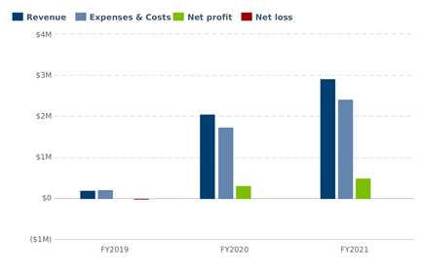
Forecast
Year | Projection (cups per day/machine) | Sales | Profit Margins
2019 | 60 | $190,512 | 47%
2020 | 80 | $2,060,796 | 47%
2021 | 100 | $2,912,370 | 47%

Slide 32
Financing Needed
1. $100,000~$200,000 10%~20% share of company
2.
3. Operating Goal (1st year)
First Bulk Purchase (14 Machines) | $105,000
Second Bulk Purchase (14 Machines) | $105,000
Operating expenses (1st year) | $100,000
Registered Users | 25,000
Cup Sales (per day per machine) | 100
Machine Locations | 28

Slide 33
Five years plan
2018
2019
2020
2021
2022
Focus on R&D
Company set up
First volume purchase (1 container) in Winnipeg
Testing Machine & beans, other drinks ingredients
Marketing strategy
Product analysis
Collecting feedbacks
R&D on robotic barista complete
New product design and volume purchase for other main cities in Canada
1st robotic barista set up
Expansion on other cities in Canada
R&D on Cashier-free coffee shop with Drive-thru
1st Cashier-free coffee shop with Drive-thru

Slide 34


Contact Information
Qichun Yu (Jackson)
jacksonyu@aimsmartcorp.com
(+1) 204-899-2862

